Slide 1
Lambda w/ EVAGreen

Slide 2
Reaction Components
1e3 copies Lambda Template
0.5 uM Primer
1x PrimeTime MM (IDT)
1x or 0.5x Dye (EVAGreen or LCGreen)

Slide 3
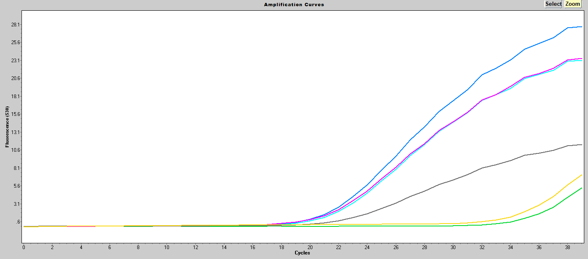
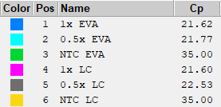
Amplification Data
530
Cp
Fmax
 | EVA | LC
1x | 21.62 | 21.6
0.5x | 21.77 | 22.53
 | EVA | LC
1x | 28.1 | 23.7
0.5 | 23.4 | 11.5
 | 1x | 0.5x
∆Cp | 0.02 | 0.76
∆Fmax | 4.4 | 11.9
EVAGreen had a lower Cp and higher Fmax than LCGreen

Slide 4
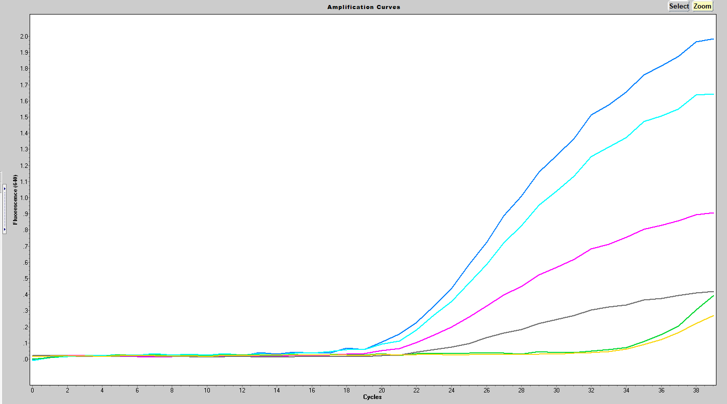
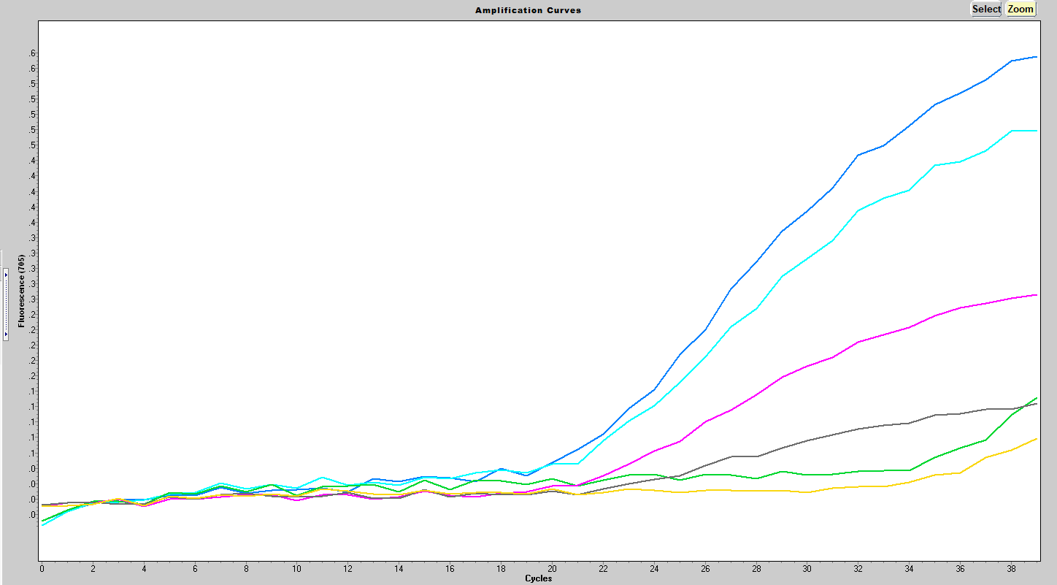
Amplification Cont’d
640
705

Slide 5
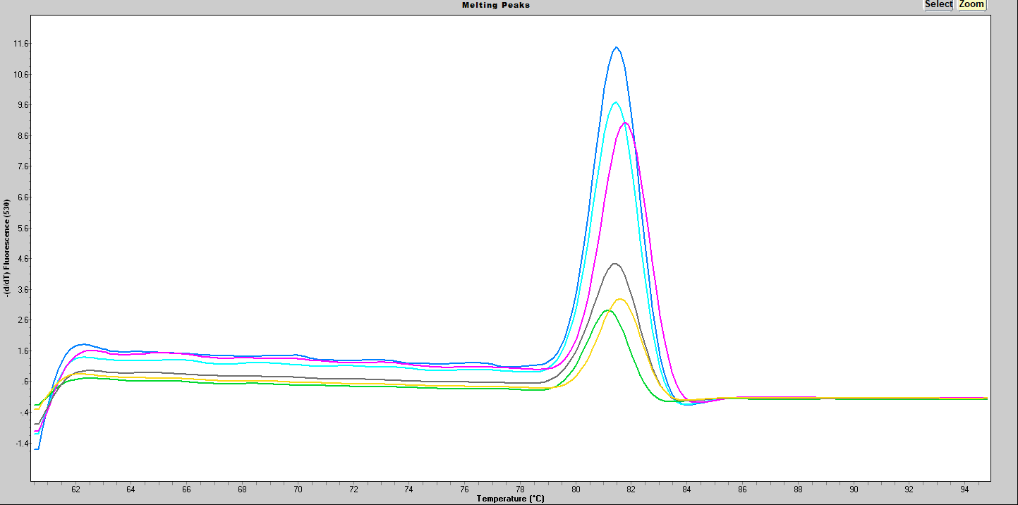
Melting Data
Tm
 | EVA | LC
1x | 78.9 | 81.55
0.5 | 79.92 | 81.15
 | 1x | 0.5x
∆Tm | 2.65 | 1.23
EVAGreen had a lower Tm than LCGreen

Slide 6
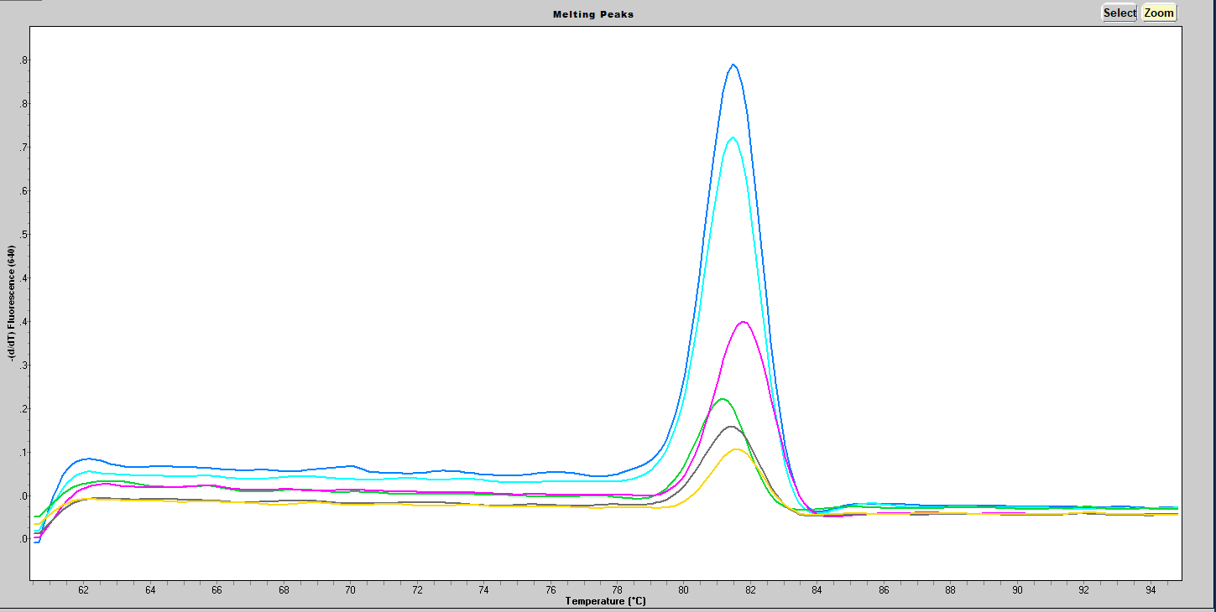
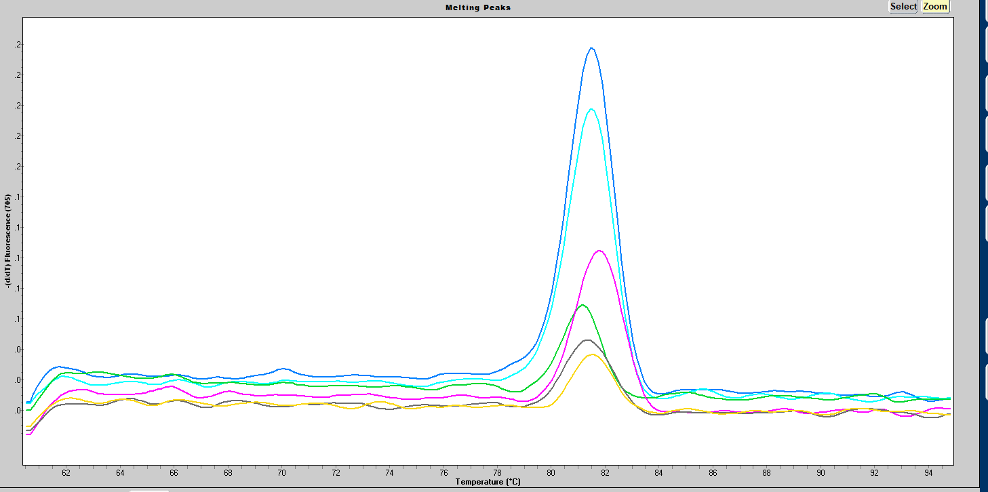
Melting Cont’d
705
640

